Slide 1
Addiction to Video Games

Slide 2
What Is Computer and Video Game Addiction?
Gaming becomes an addiction when it starts to interfere with a person's relationships or their pursuit of other goals
Young people, who often feel powerless in their daily lives, suddenly have the ability to command armies, drive (and crash) cars, and wreak havoc on a virtual world with no real-life consequences. This is seductive!
A shy child can suddenly became gregarious;
A passive child can become aggressive.

Slide 3
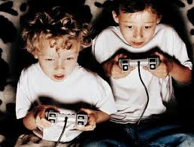
It causes many mental disorders
This is a mental illness issue

Slide 4
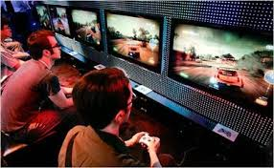
Mass panel for Xbox 360

Slide 5


Slide 6
What is Addiction?
Video game addiction is not a statistic but would be similar to any other psychological addiction
It is considered to be an impulse control disorder

Slide 7
Forms of Gaming
There are two forms of gaming
Offline
Games like Grand Theft Auto, that is played on a computer or game console such as a Xbox
Online
Games such as EverQuest, that are played with a broadband connection(preferably) that usually charges a small fee

Slide 8
Symptoms of Video Game Addiction
Playing video games for more than 3 hours per sitting.
Passing up activities that are normally enjoyed.
Neglecting work to play the game.
Getting restless or irritable if you can’t play the game.
Trying unsuccessfully to limit or stop game playing.

Slide 9
Symptoms of Addiction
Persistent thoughts of playing the game
Use the game to escape problems
Increased time spent with game to receive same satisfaction
Inability to control, stop or diminish the behavior
Irritability when prevented from playing the game.
Lying about extent of involvement with the game

Slide 10
Affects of Addiction
A 2004 study showed 4 common indicators
Shyness
Lack of spiritual faith
Belief of other controlling their lives
Elevated belief in chance as an influence on their lives

Slide 11
Physical Consequences of Gaming Addiction
Migraines (it is type of headache)
Sleep Disturbances
Backaches
Eating Irregularities
Poor Personal Hygiene

Slide 12
Solutions For The Addiction
Provide other activities.
Lessen the time spent playing games.
After school activities.
Sports.
Set a schedule.

Slide 13

The reality is that the computer games children play are primarily for pure entertainment, not for education.

Slide 14
So………………..
don’t
Addict2games

Slide 15


